Slide 1

A Project Review Meeting on Campus Internship Tracker
By
Name Jawwad roll 2420030075
Name Anudeep roll 2420030148
Name Sri charan roll 2420030127
Name Dhanusha roll 2420030159
Team Number: 8
Under the guidance of
Dr. Nirmalajyothi
Associate Professor
Department of Computer Science and Engineering
Koneru Lakshmaiah Education Foundation (Deemed to be University estd. u/s. 3 of the UGC Act, 1956) Off-Campus: Bachupally-Gandimaisamma Road, Bowrampet, Hyderabad, Telangana - 500 043. Phone No: 7815926816, www.klh.edu.in

Slide 2
Reference platforms considered
We studied the following platforms:
Internshala
Handshake
ImBlaze
OpenWater
GoSprout
These platforms help manage internships but still have certain limitations.

Slide 3
Current Challenges:
• Students struggle to find relevant internships
• No centralized platform for internship management
• Manual application tracking is inefficient
• Lack of real-time application status updates
• No proper communication between students and admins
Solution:
A comprehensive web platform connecting students with
internship opportunities and enabling admins to manage
the entire process efficiently.
PROBLEM AND SOLUTION

Slide 4
PROJECT OVERVIEW
Objectives:
✓ Streamline internship discovery and application process
✓ Provide real-time application tracking
✓ Enable admins to manage internships and applications
✓ Generate insights through analytics dashboard
✓ Role-based access control (Student & Admin)

Slide 5
TECHNOLOGY STACK
BACKEND:
• Java 17 • Spring Boot 3.2.0
• Spring Data JPA • Hibernate ORM
• MySQL Database • Maven Build Tool
FRONTEND:
• HTML5 • CSS3
• JavaScript (ES6) • Chart.js for Analytics
• Font Awesome Icons • Responsive Design
TOOLS:
• Git Version Control • Postman API Testing
• VS Code / IntelliJ • MySQL Workbench

Slide 6
KEY FEATURES
STUDENT
• Register / Login / Forgot Password
• Browse & Search Internships
• Apply with Resume & Cover Letter
• Track Application Status
• Save/Bookmark Internships
• Receive Notifications
• Download Offer Letter when Selected
ADMIN
• Dashboard with Stats & Charts
• Add/Edit/Delete Internships
• View & Filter Applications
• Update Status (Shortlist/Select/Reject)
• Manage Students
• Send Broadcast Notifications

Slide 7
CONCLUSION
PROJECT SUMMARY:
• Complete internship management system
• Role-based access (Student & Admin)
• Real-time application tracking
• Interactive dashboards with analytics
• 15 Students | 15 Internships | 50+ Applications
FUTURE SCOPE:
• AI-based internship recommendations
• Email notifications
• Mobile application
• Resume parsing
TEST CREDENTIALS:
Student: aarav@test.com / student123
Admin: admin@test.com / admin123

Slide 8
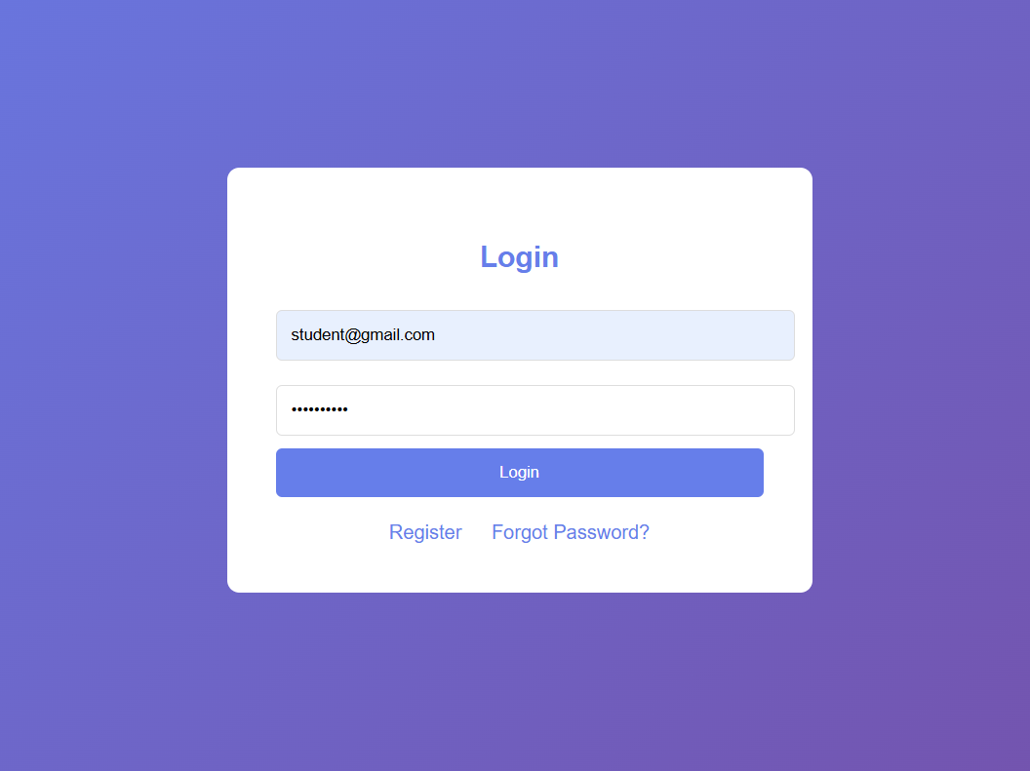

Slide 9
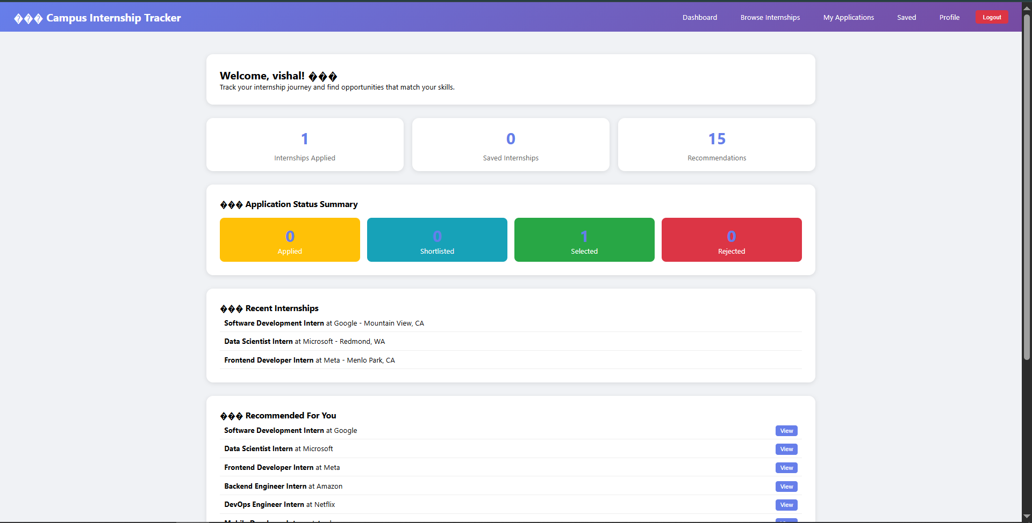

Slide 10
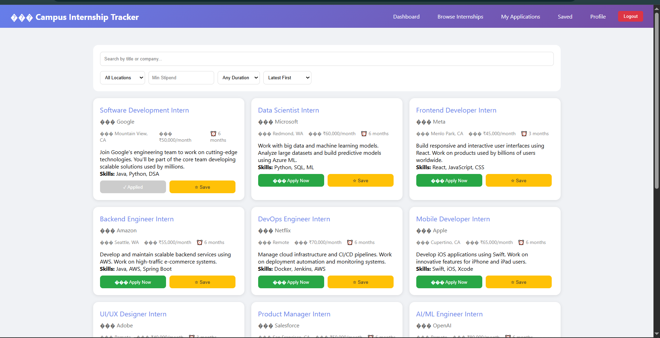

Slide 11
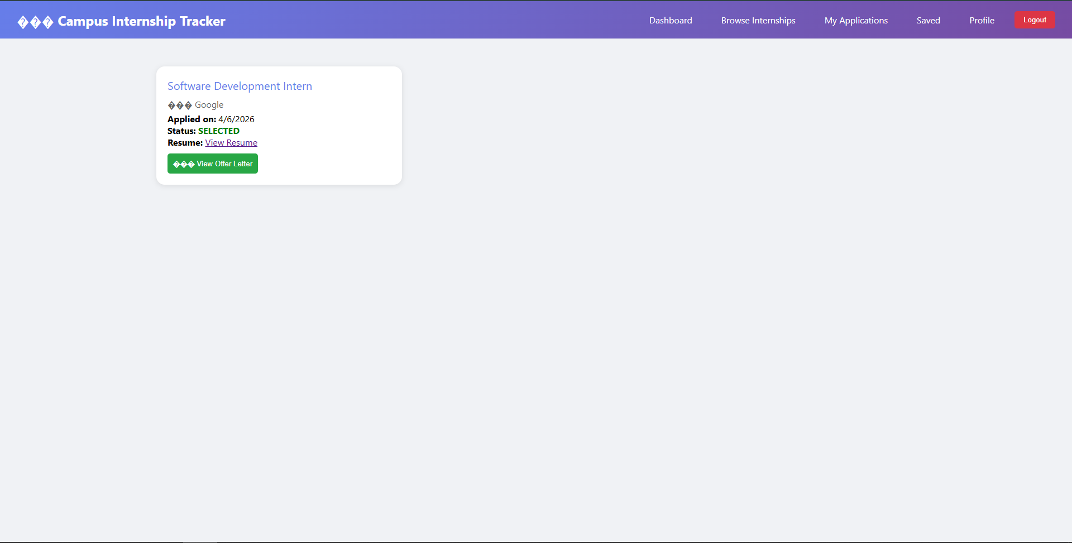

Slide 12
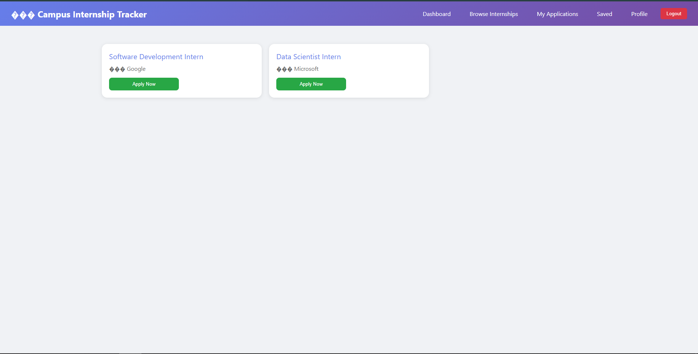

Slide 13
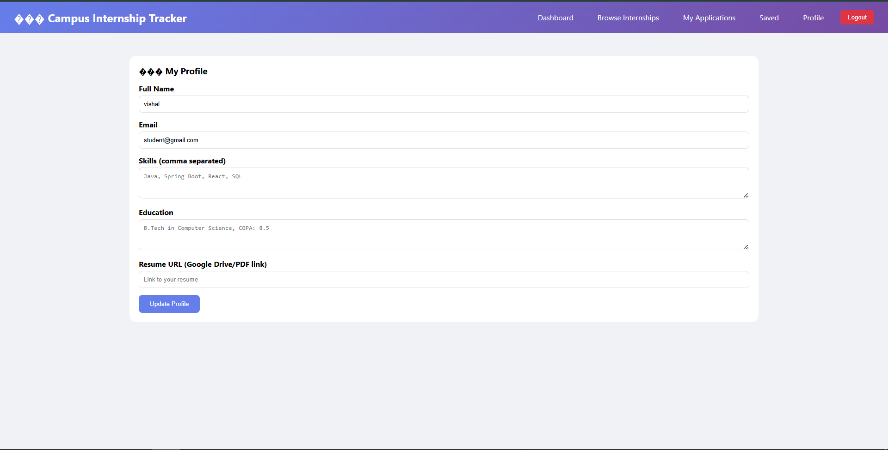

Slide 14
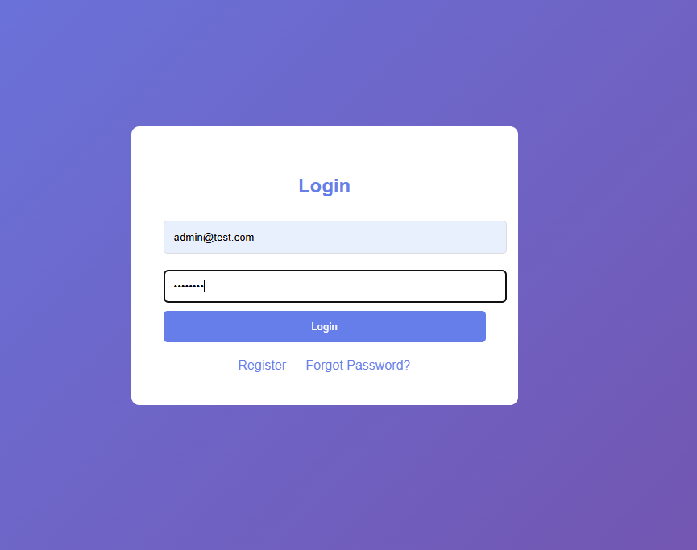

Slide 15
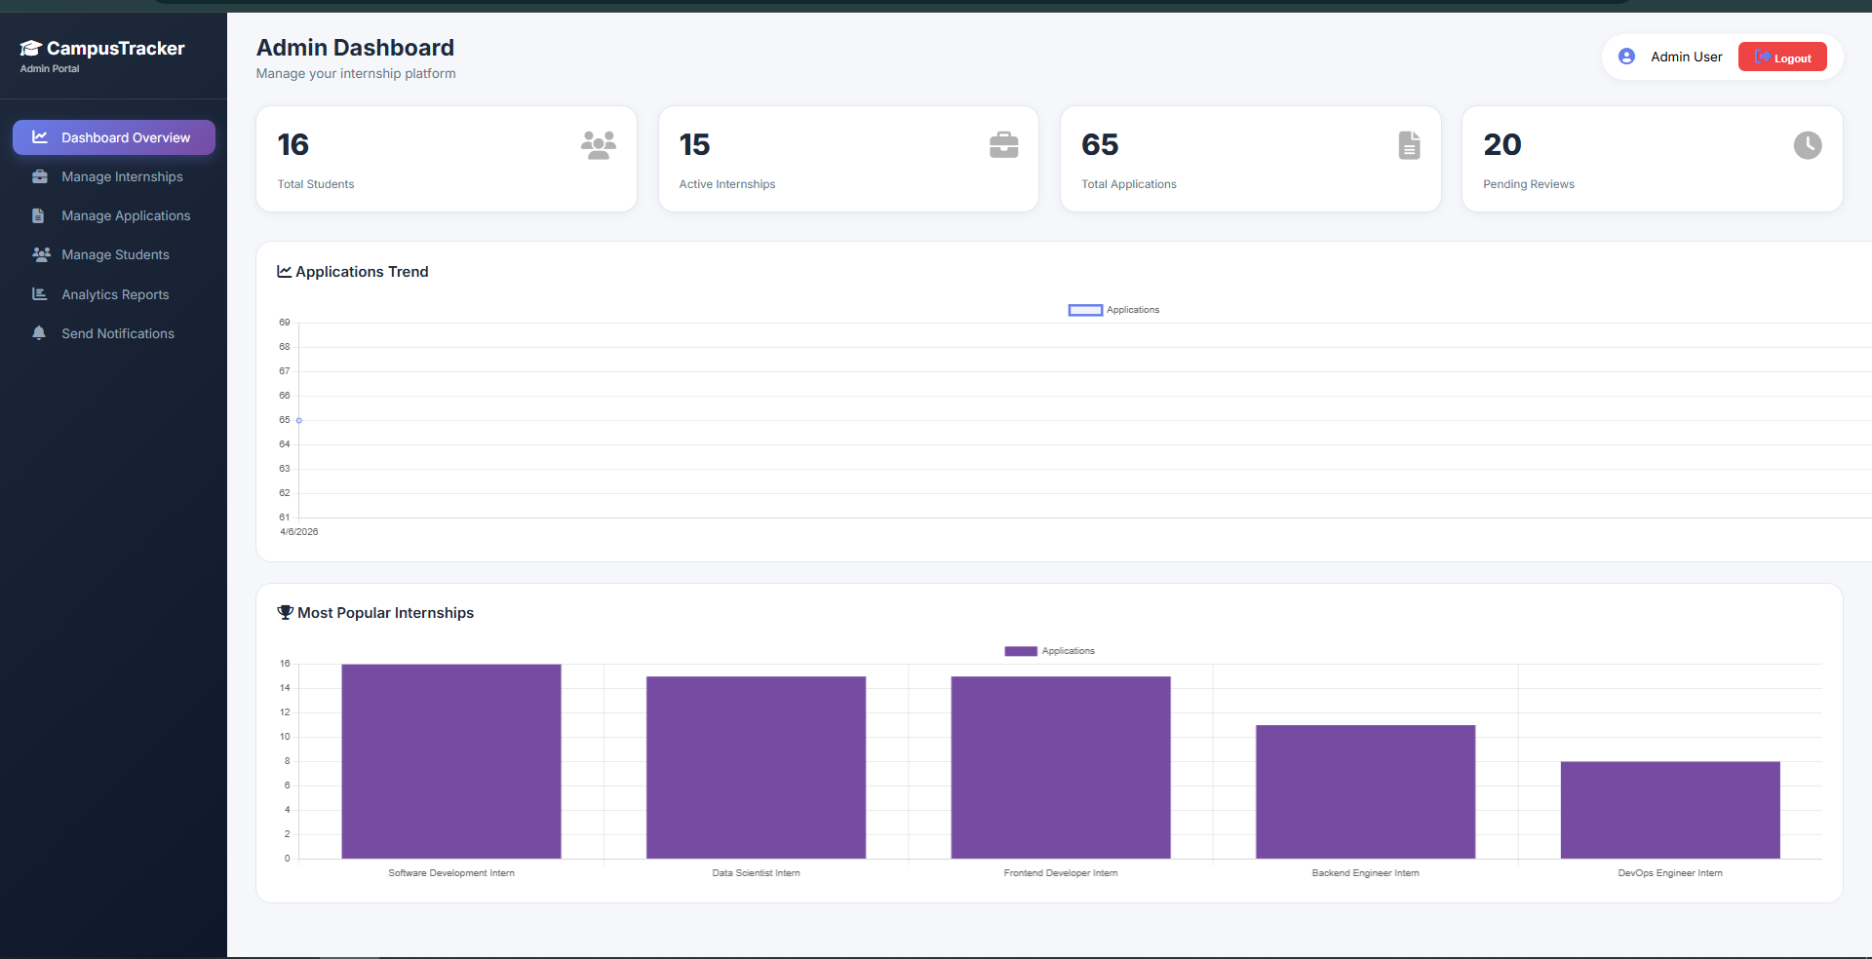

Slide 16
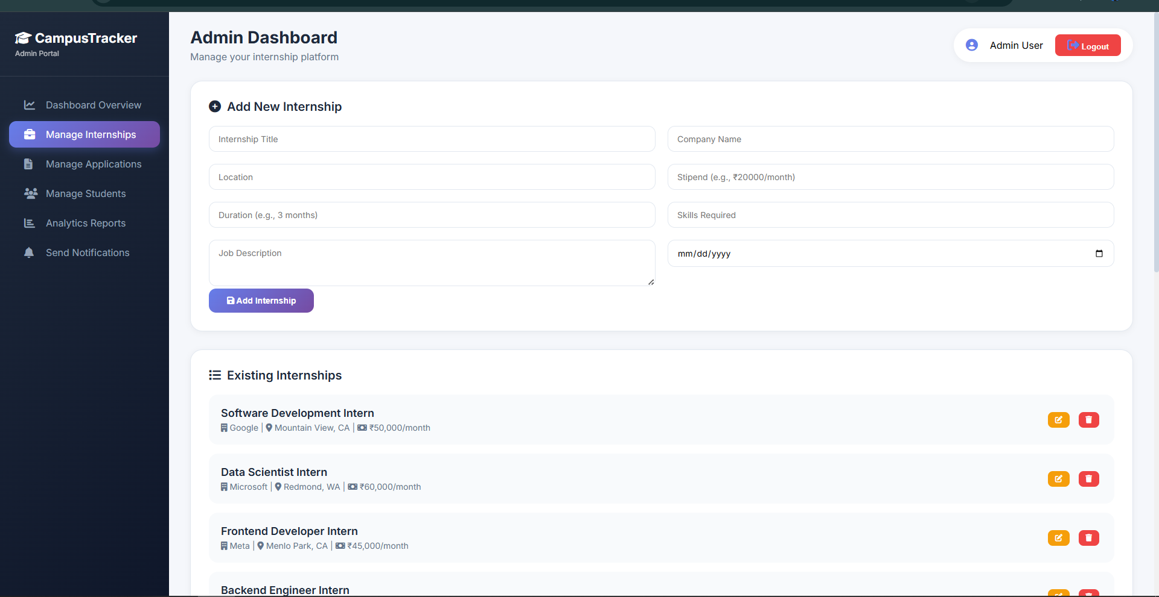

Slide 17
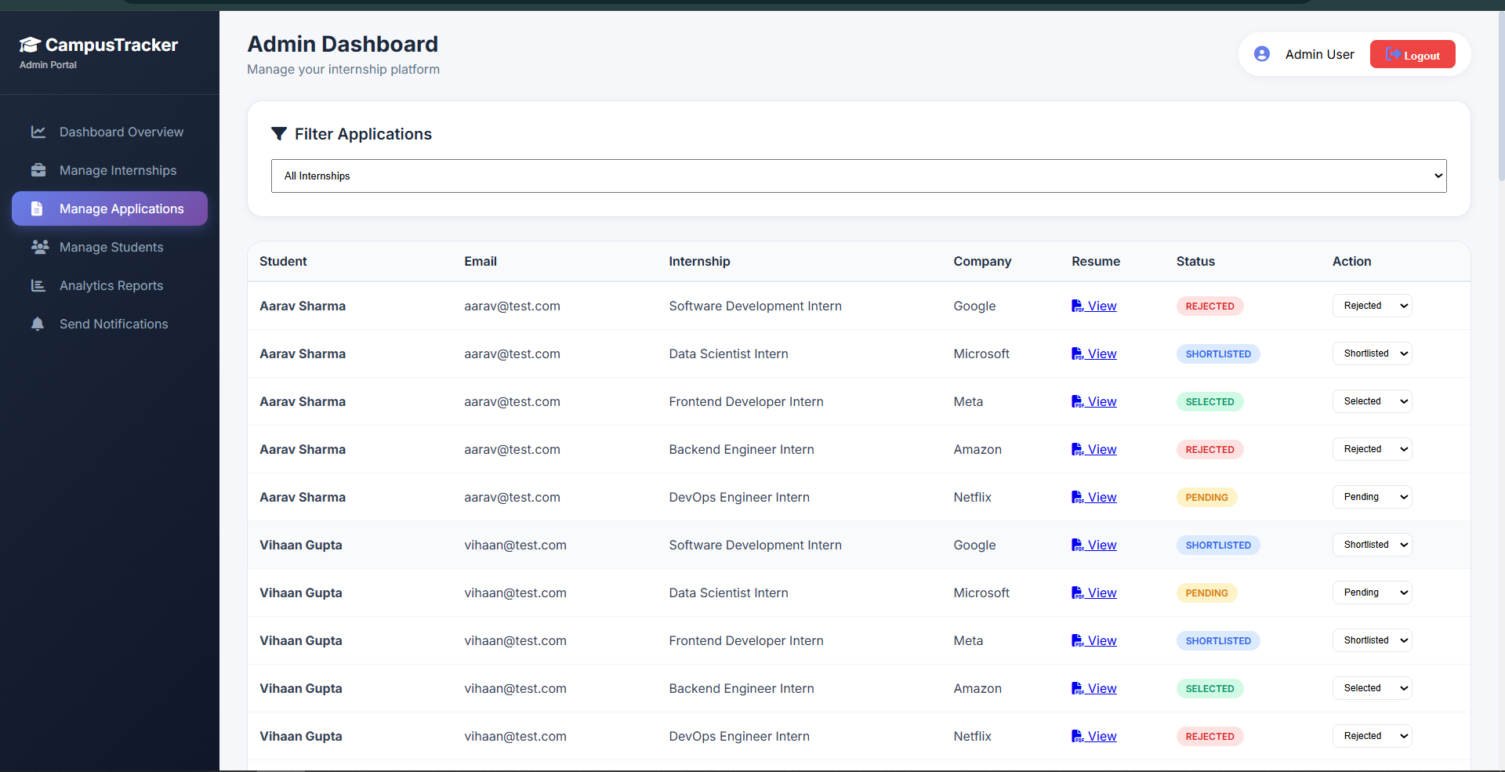

Slide 18
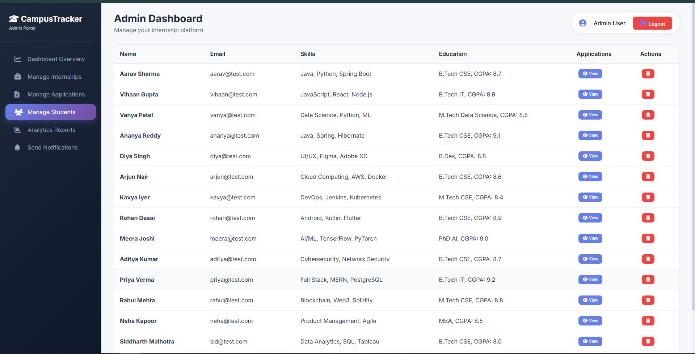

Slide 19
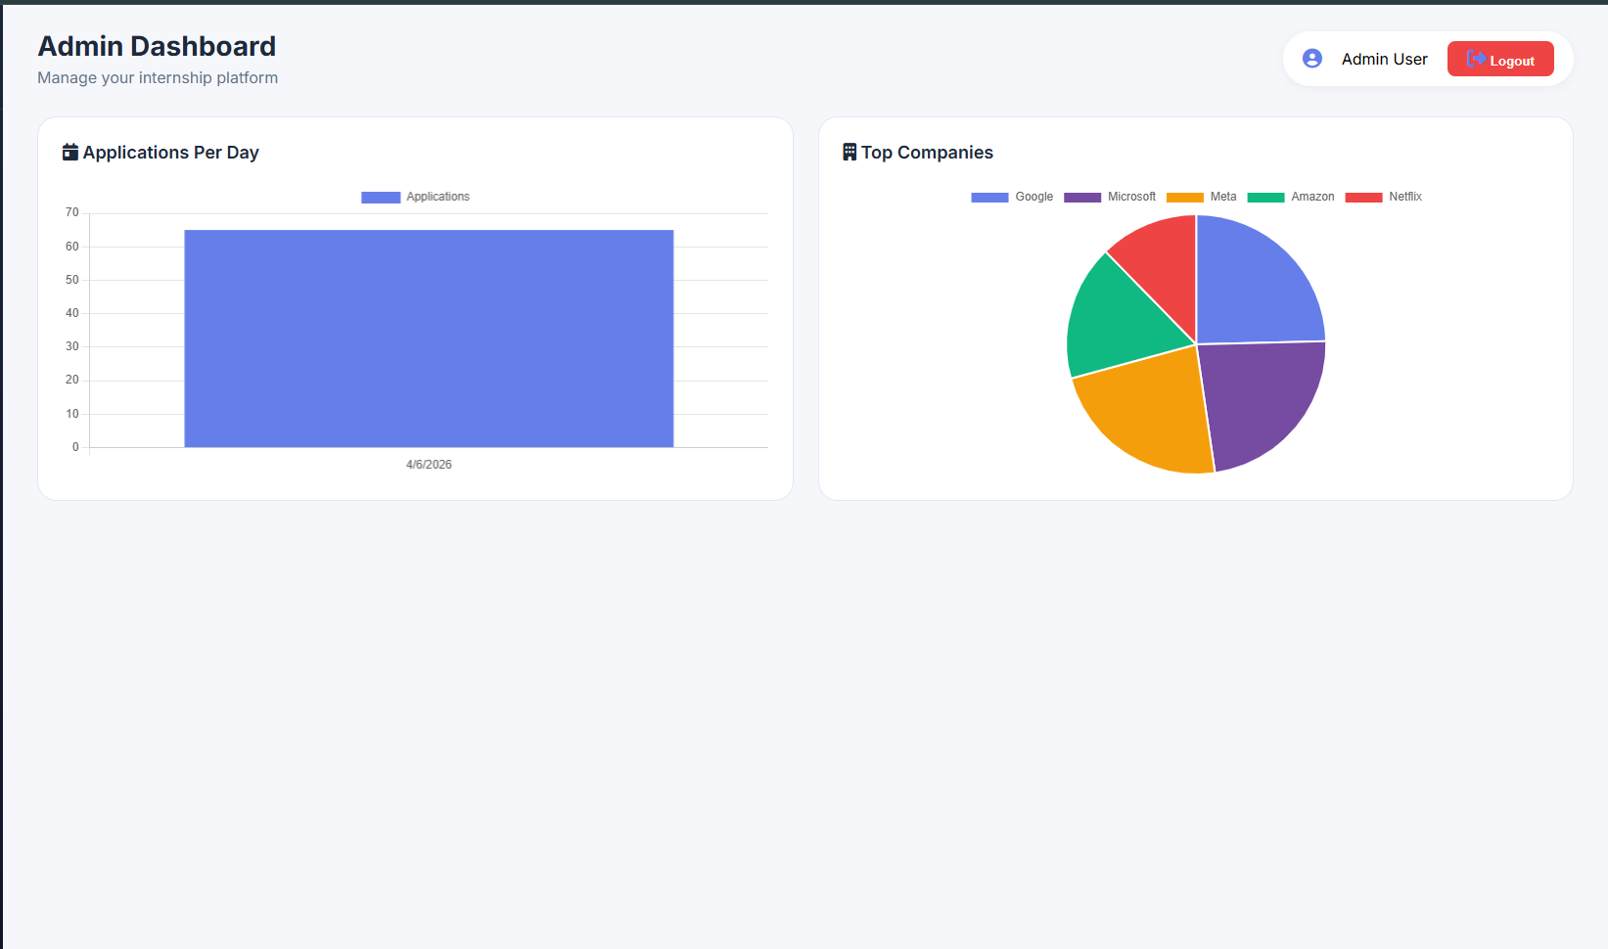

Slide 20
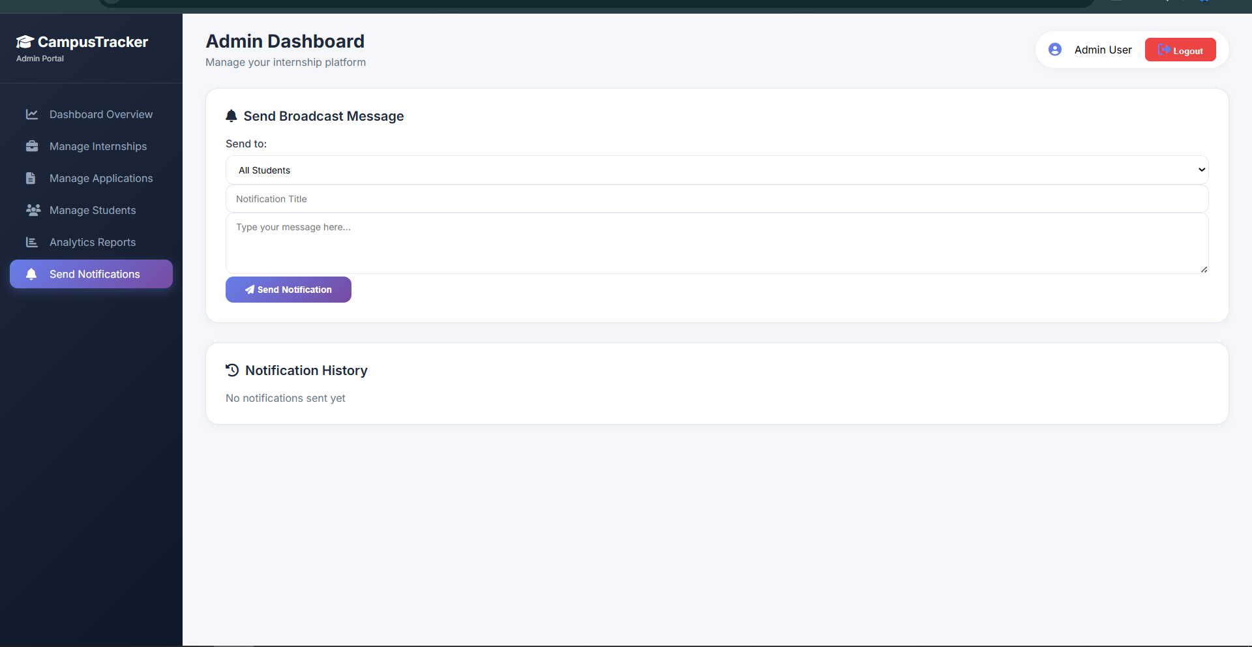

Slide 21
Thank you

